Slide 1

Visualizing Uncertainty with Chromatic Aberration
MCSc Thesis Defence
Md Rashidul Islam
10 May 2022
Examining Committee
Dr. Stephen Brooks (Supervisor)
Dr. Fernando Paulovich (Reader)
Dr. Joseph Malloch (Reader)
Dr. Dirk Arnold (Chair)

Slide 2
Contents
Background
Prior Work
Data Generation
Chromatic Aberration
Exploratory Designs
User Study Design
Quantitative Test
Conclusion
Future Work
Questions?

Slide 3
Background

Slide 4
What is Uncertainty?
In practice, uncertainty is defined as doubt about something.
In digital the world, uncertainty refers to imperfect, unknown, lack of sureness or certainty in information.

Slide 5
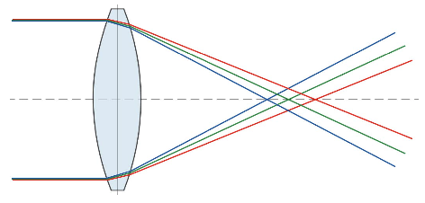
What is Chromatic Aberration?
Chromatic aberration is an effect that occurs when a lens is not able to properly refract all the wavelengths of colour in the same point.
We call Chromatic Aberration as CA throughout the talk.
Light refraction at different angles

Slide 6
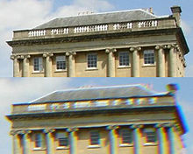
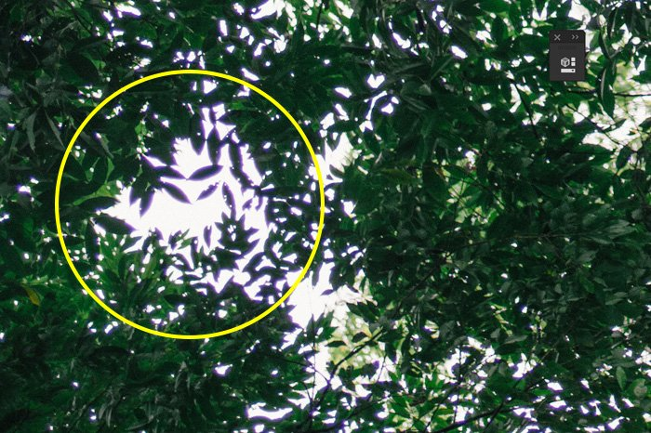
Examples of CA
Real World Chromatic Aberrations

Slide 7
Prior Work

Slide 8
Prior Work
Koh et. al. (2014) observe the effect on users’ judgment with Lateral Chromatic Aberration (LCA).
Johnson et al. (2006) shows that inconsistencies in lateral chromatic aberration can be used to detect tampering in forgeries.
Healey et al. (1998) presents a new method for using texture to visualize multidimensional data elements with separate texture dimensions: height, density, and regularity.

Slide 9
Prior Work
Sathler et al. (2017) shows Neural network models (MLP, LSTM, GRU) significantly outperforms.
Pang et al. (1997) introduced a variety of uncertainty visualization methods (glyphs, adding geometry, modifying attributes, modifying geometry, animation, etc)
In Schneider et al. (2021) introduced: forecast and uncertainty maps, map with the uncertainty shown by the transparency; and two maps that showed the lower and upper bounds of the forecast

Slide 10
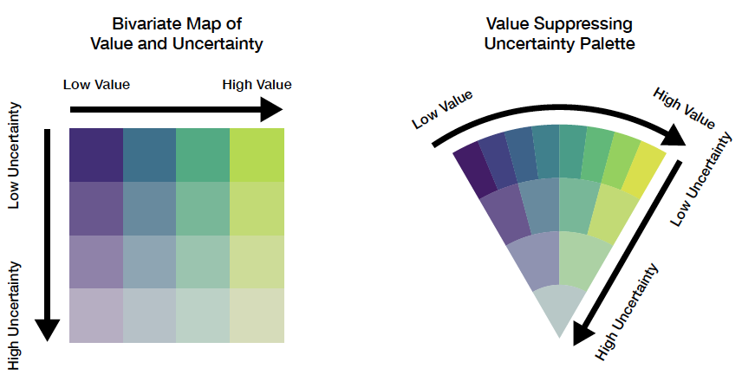
Prior Work
Correll et al. (2018) brought up a new approach of uncertainty-aware decision-making strategy
Bivariate Map (common approach)
VSUP (Value Suppressing Uncertainty Palettes)

Slide 11
Data Generation

Slide 12
Uncertainty Data Generation Flow
Training Data
Forecasting Algorithms
Model
After Training
New Data (Optional)
Model
Predictions
Calculate Uncertainty
Data with Uncertainty

Slide 13
Predictive Algorithms
MLP (Multilayer Perceptron)
CNN (Convolutional Neural Network)
LSTM (Long-Short Term Memory)
Auto Arima

Slide 14
Uncertainty Comparison among Models
Country | MLP | CNN | LSTM | ARIMA
United States | 7.00 | 7.00 | 3.44 | 7
India | 4.28 | 0.61 | 7.00 | 3.52
Brazil | 3.64 | 0.51 | 3.24 | 1.27
Kazakhstan | 2.43 | 0.42 | 0.35 | 0.17
France | 2.15 | 0.31 | 0.81 | 0.56
Peru | 1.28 | 0.23 | 0.28 | 0.22
Germany | 1.21 | 0.19 | 0.50 | 0.51
Spain | 1.07 | 0.19 | 0.67 | 0.33
Turkey | 1.03 | 0.19 | 1.21 | 0.30
Argentina | 1.02 | 0.14 | 1.08 | 0.25

Slide 15
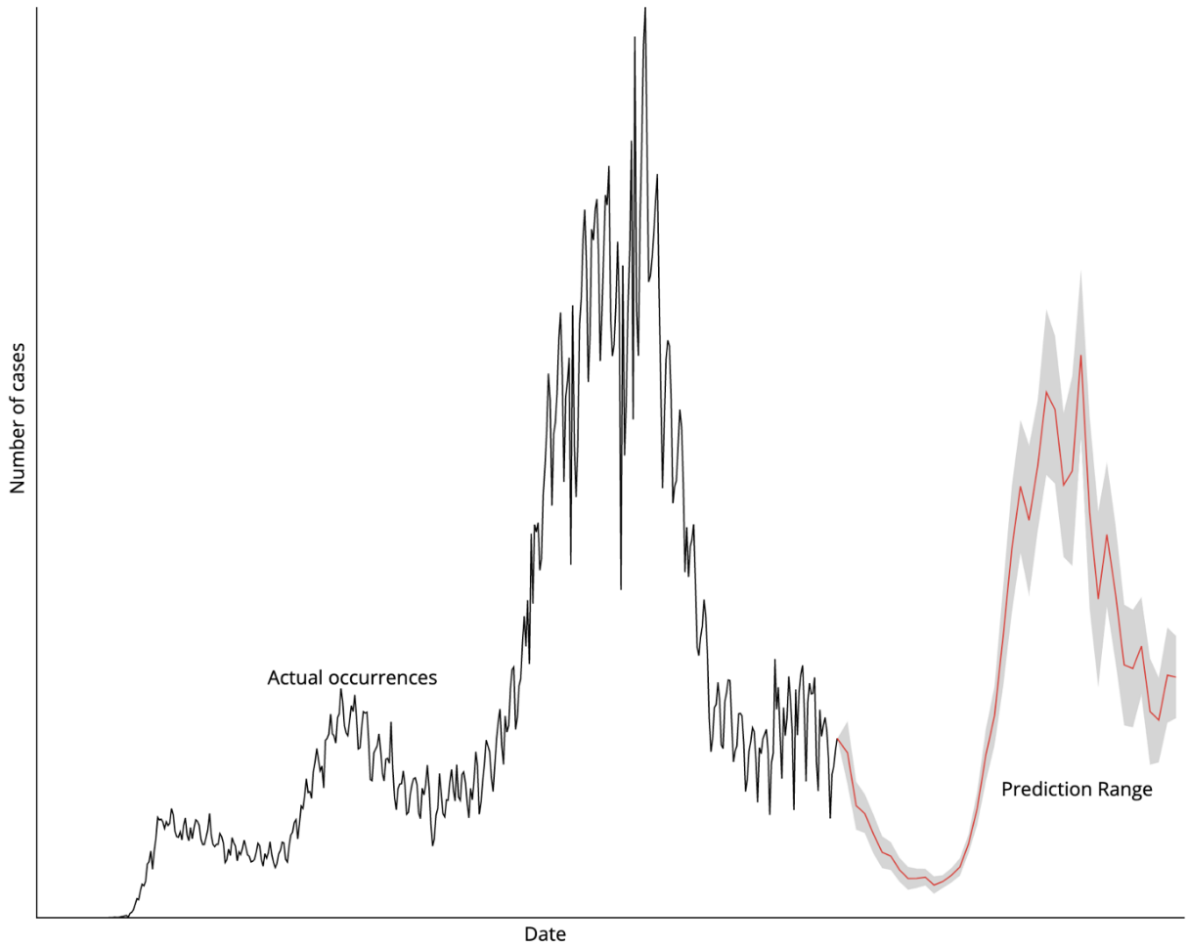
Uncertainty in Prediction

Slide 16
Chromatic Abberation

Slide 17
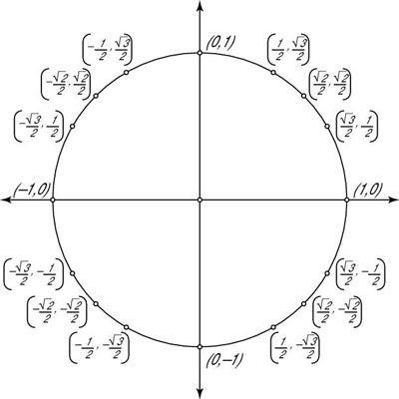
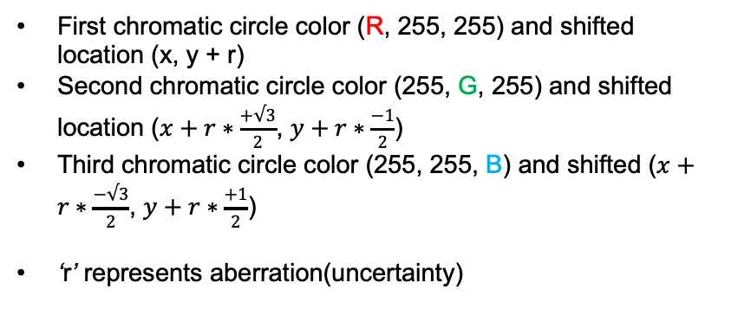
Architecture of CA
First chromatic circle color (R, 255, 255) and shifted location (x, y + r)
Second chromatic circle color (255, G, 255) and shifted location ($x+r∗\frac{+√3}{2}$, $y+r∗\frac{−1}{2}$)
Third chromatic circle color (255, 255, B) and shifted ($x+r∗\frac{−√3}{2}$, $y+r∗\frac{+1}{2}$)
‘r’ represents aberration(uncertainty)
(x, y)

Slide 18


CA on a Circle
Three overlapping circles filled by rgb (100, 255, 255), rgb (255, 149, 255), rgb (255, 255, 180)
Used mix-blend-mode to darken

Slide 19
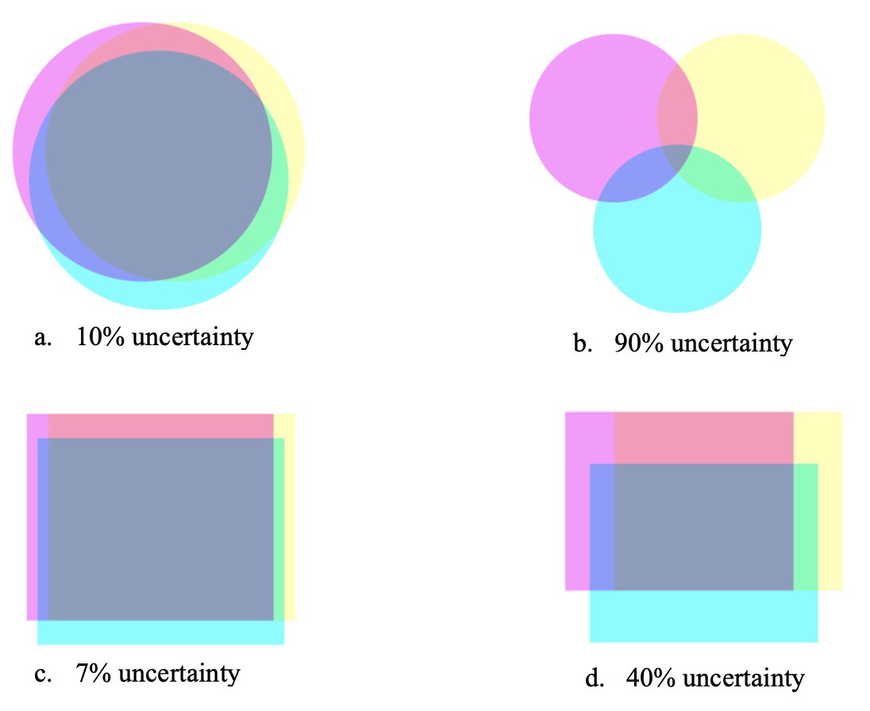
More Examples of CA Shapes

Slide 20
(breifly) Exploratory Designs

Slide 21
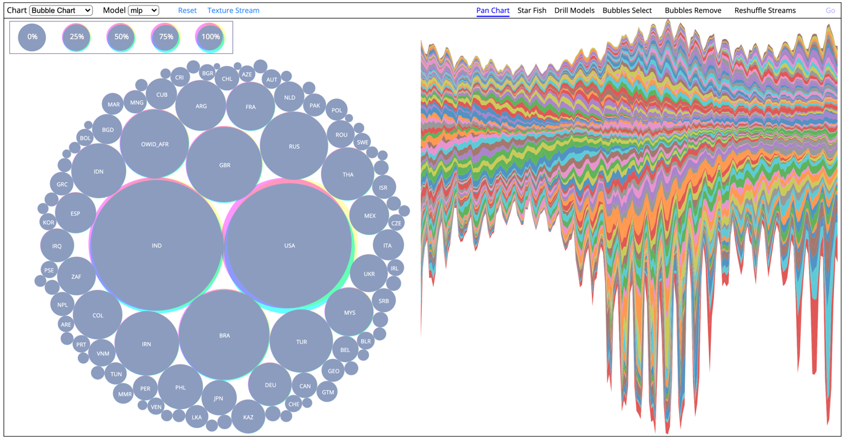
Web Interface

Slide 22
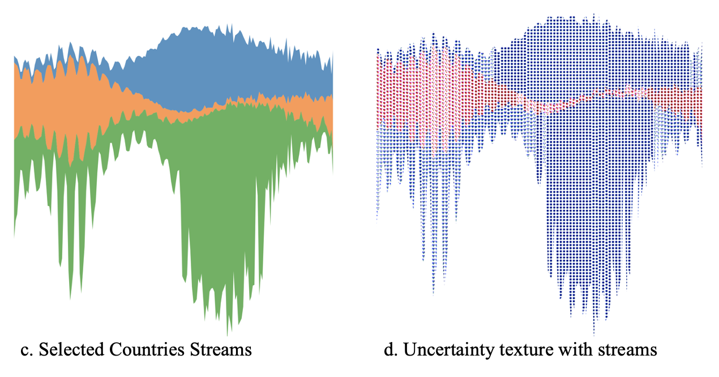
Reshufling
Side by side uncertainty comparison among three selected countries.

Slide 23
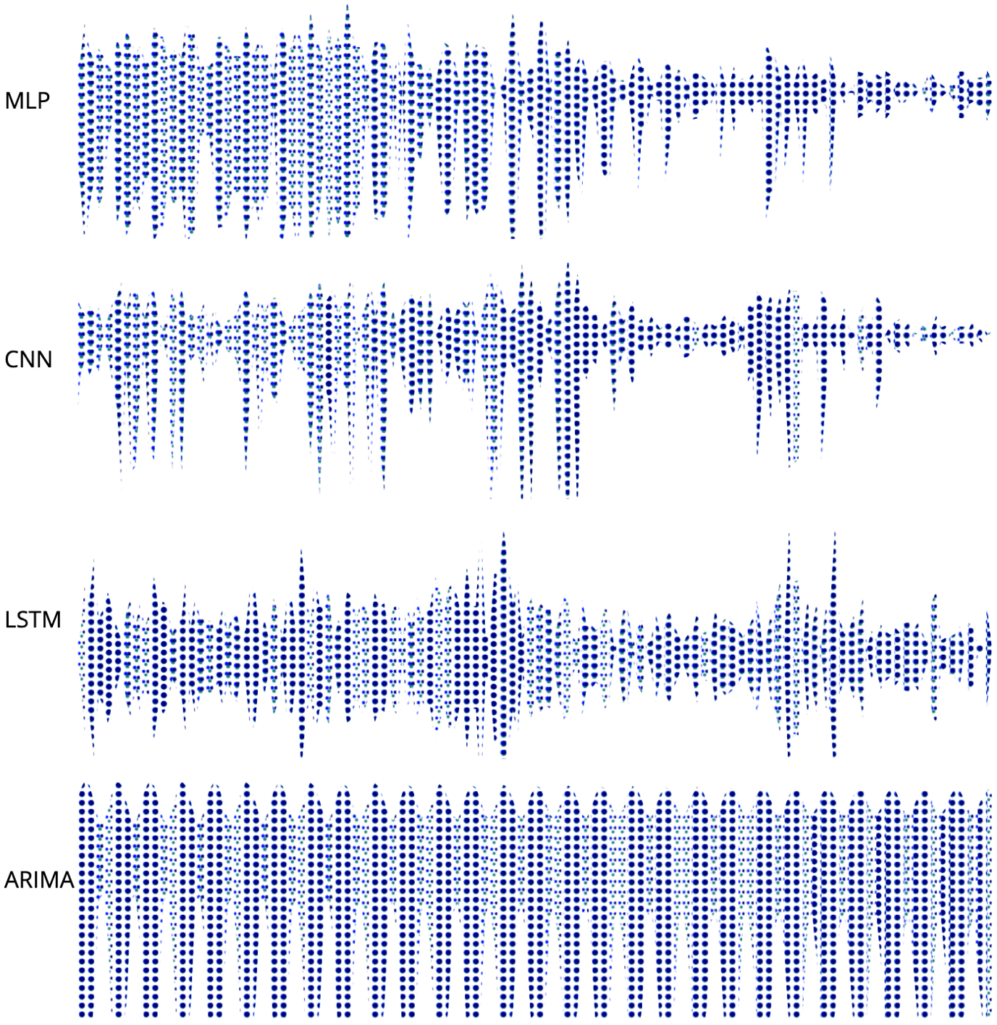
Drill-down
Side by side uncertainty comparison among four model predictions
Each column represents an uncertainty in the range 1-9

Slide 24
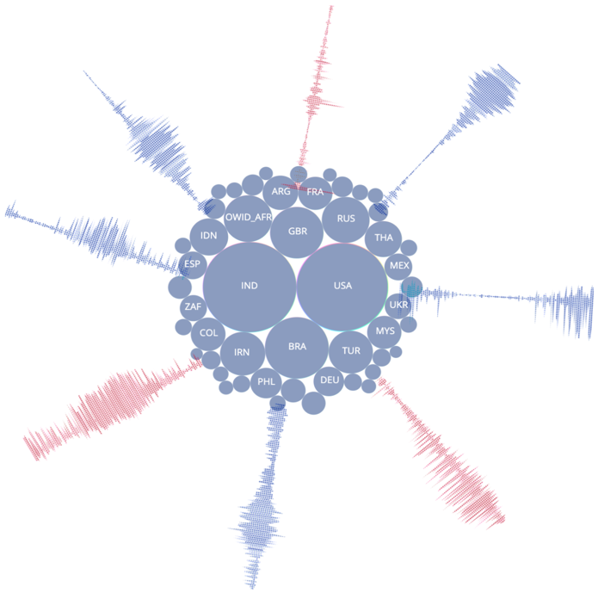
Star-Fish Layout
Side by side uncertainty comparison among four model predictions

Slide 25
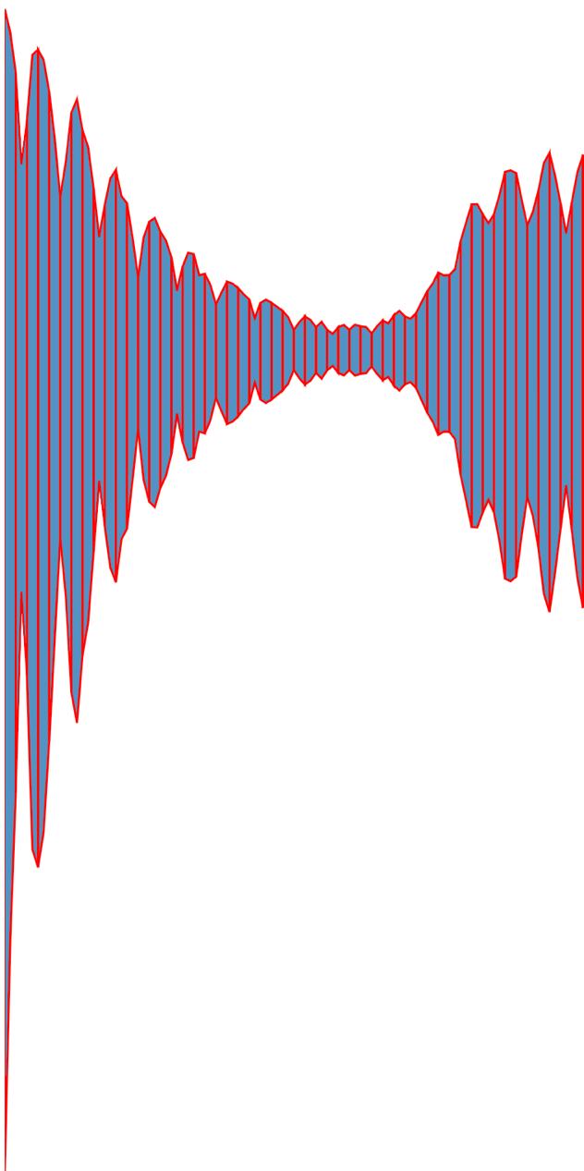
Streamgraph Slicing
Averaging every three consecutive days.

Slide 26
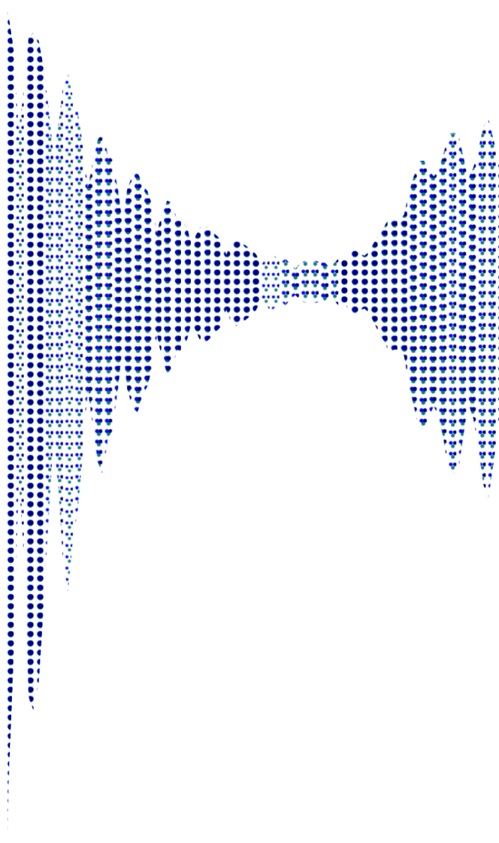
Streamgraph with CA
Assigning texture pattern to every slice.
Every slice has different amount of uncertainty (CA).

Slide 27
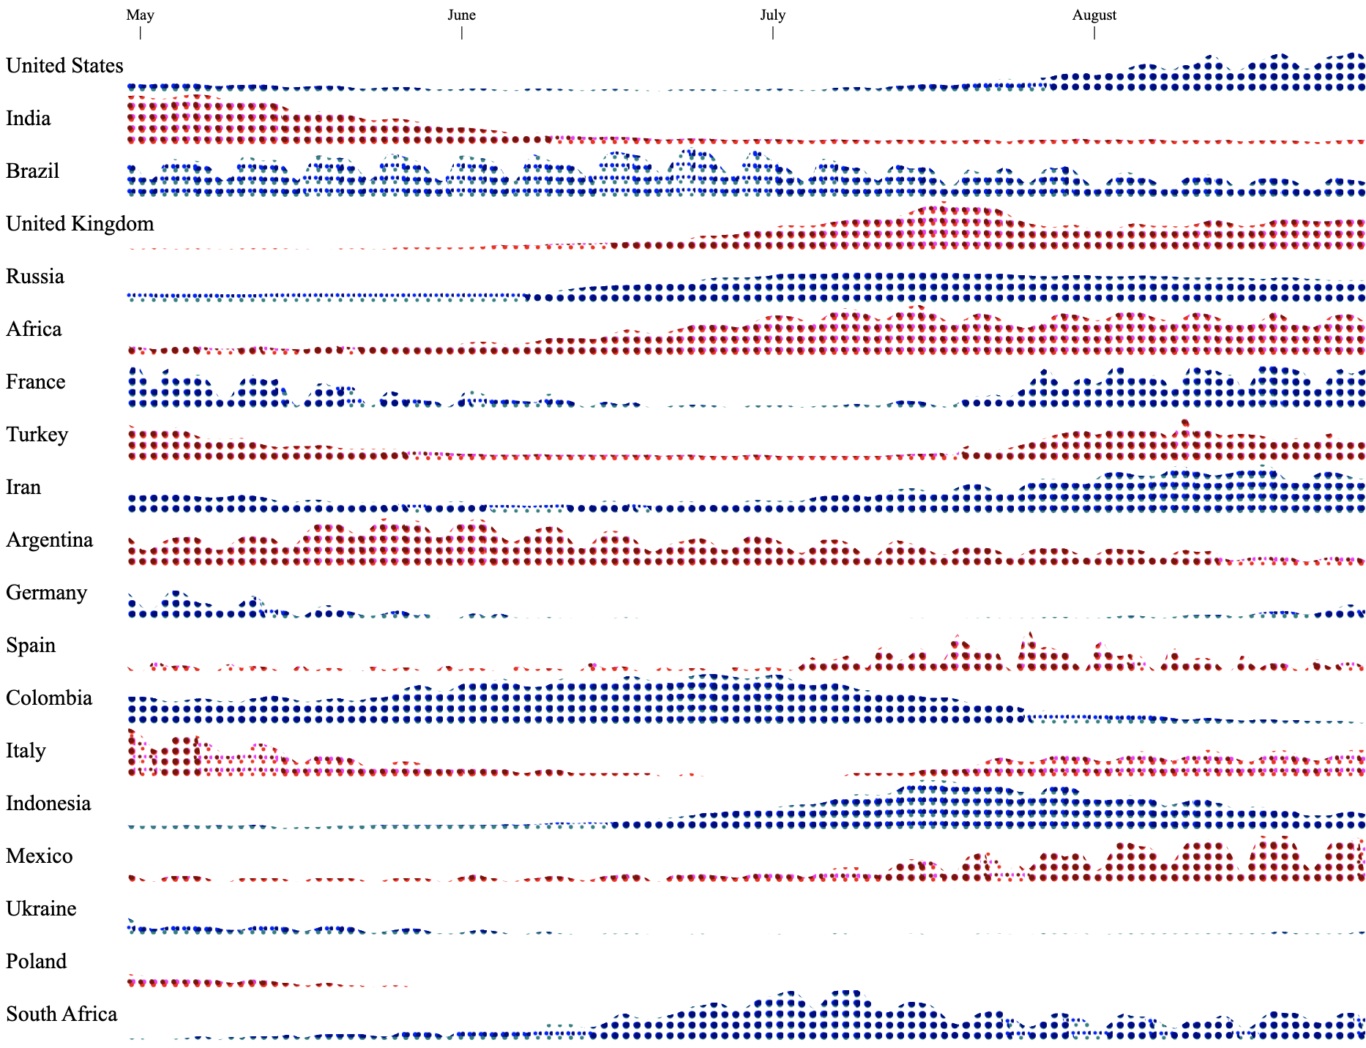
Horizontal Chart
Every country is kind of stream graph.
Every 3 consecutive days refers to a column

Slide 28
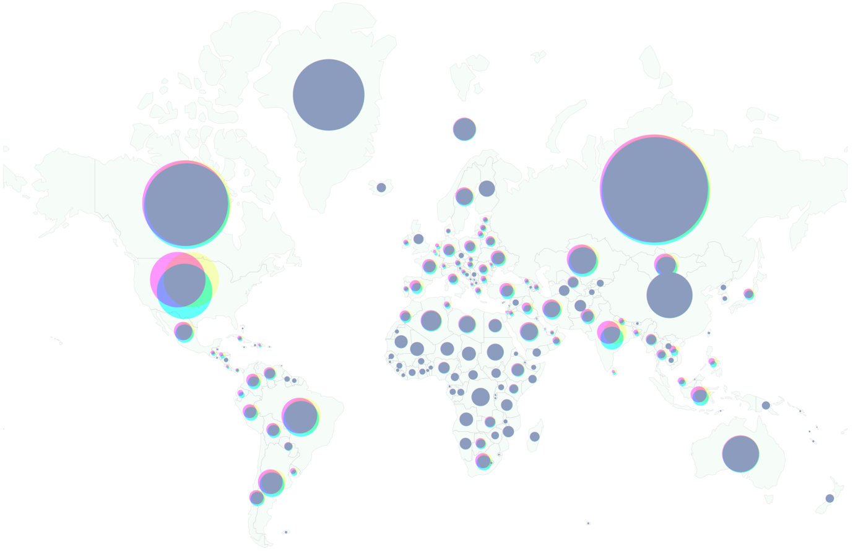
World View

Slide 29
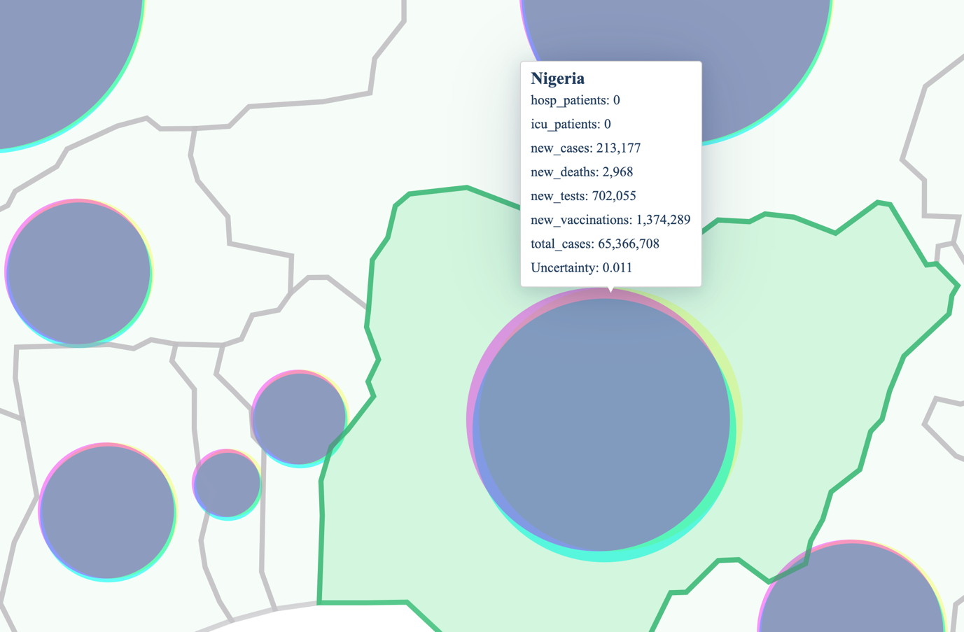
Zoomed view

Slide 30
User Study

Slide 31
User Study Overview
A comparative (VSUP vs CA) within-subject design
Latin squares balancing
Participation criteria
Color blindness test
Computer & Good Internet Connection
Post Secondary Education
Measures
User timings
Accuracy
Subjective assessments (SUS, NASA-TLX)

Slide 32
Components of the Study
CA + Bubble
CA + Grid
VSUP + Bubble
VSUP + Grid

Slide 33
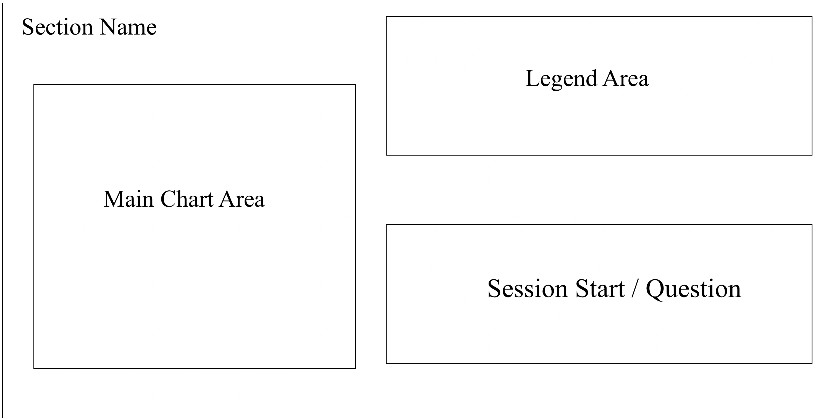
Questionnaire Layout

Slide 34
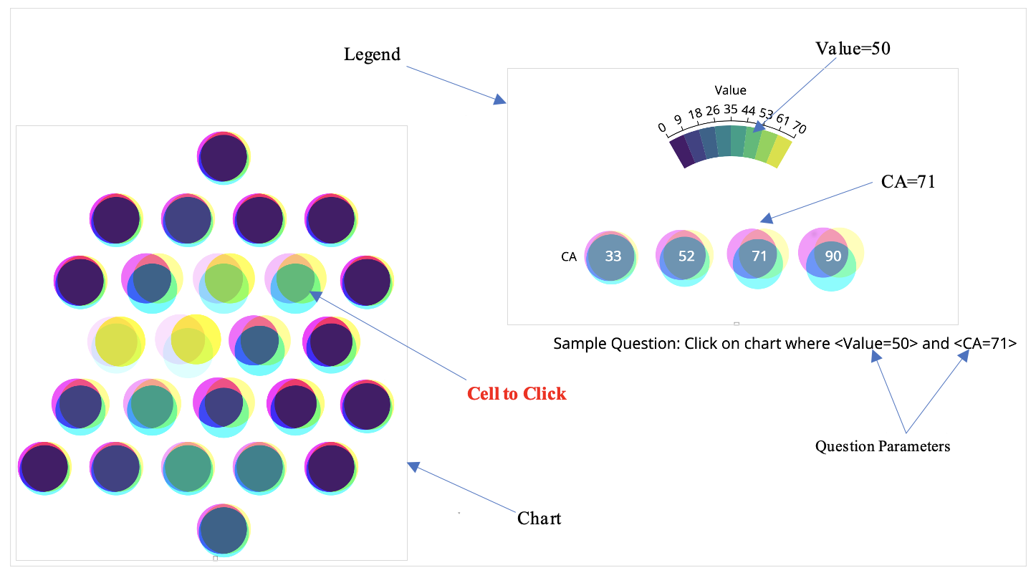
CA + Bubble

Slide 35
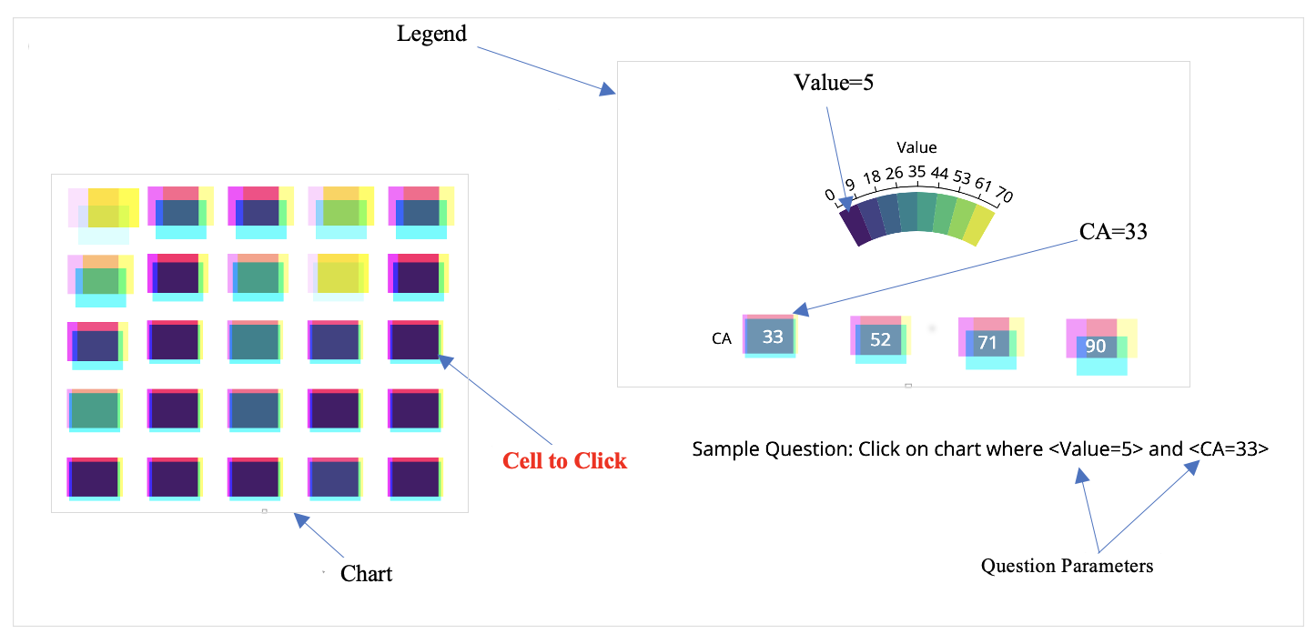
CA + Grid

Slide 36
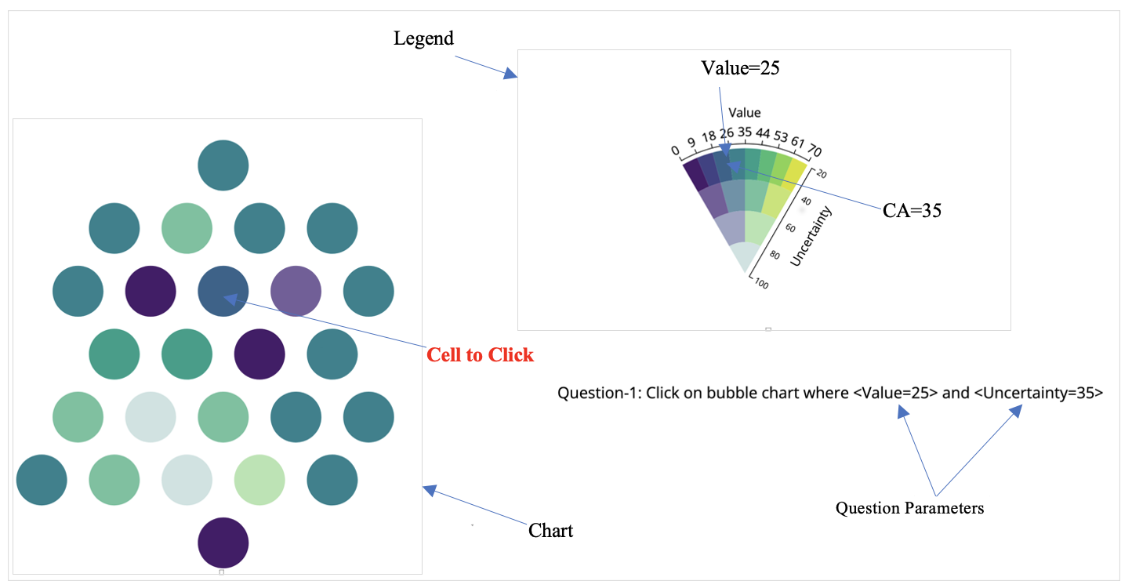
VSUP + Grid

Slide 37
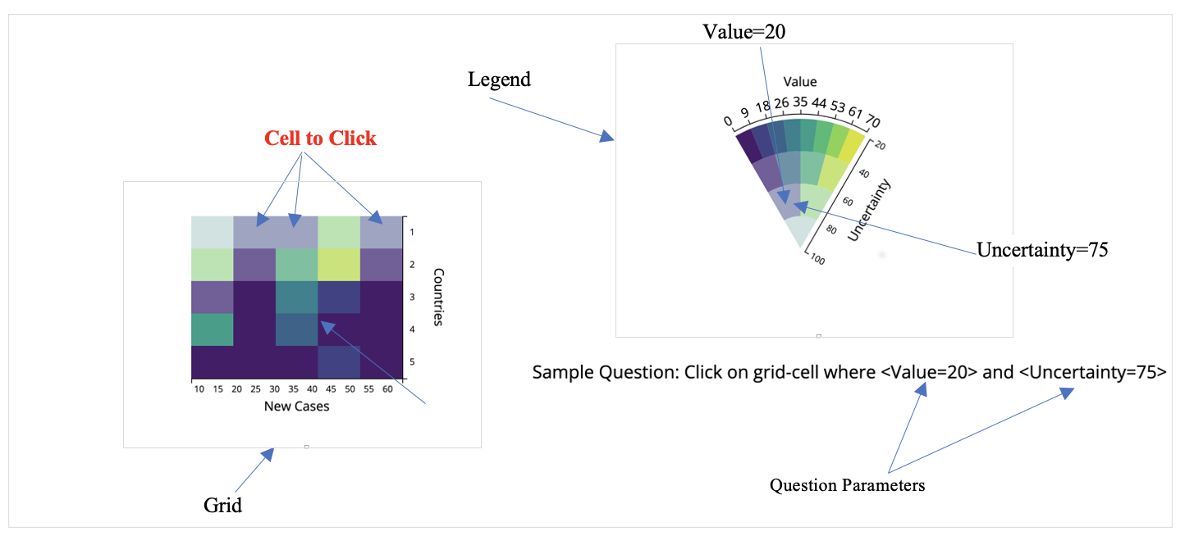
VSUP + Grid

Slide 38
Results

Slide 39
Quantitative Questionnaire
Groups | N | Mean | Std. Dev. | Variance | Std. Error.
CA + Bubble | 32 | 6.2813 | 1.301 | 1.692 | 0.23
CA + Grid | 32 | 5.5938 | 1.2916 | 1.668 | 0.2283
VSUP + Bubble | 32 | 5.6563 | 1.4053 | 1.975 | 0.2127
VSUP + Grid | 32 | 5.1875 | 1.2032 | 1.456 | 0.2127
ANOVA Data summary
The results of a one-way ANOVA is considered reliable if
Samples are independent
Variances of populations are equal
Response variable is normal

Slide 40
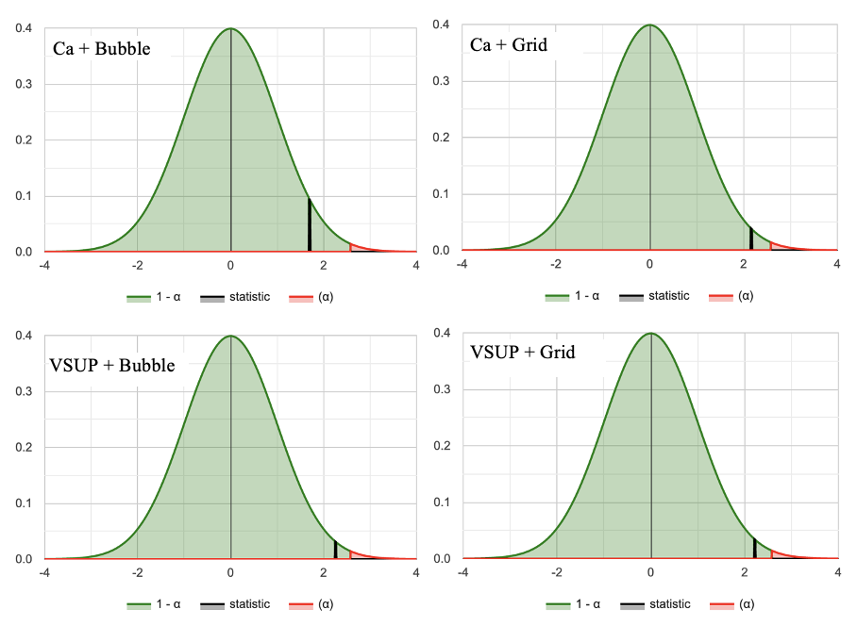
Normality Test
Component | W | P | Status
Ca + Bubble | 0.915 | 0.015 | Normal
Ca + Grid | 0.932 | 0.045 | Normal
VSUP + Bubble | 0.911 | 0.012 | Normal
VSUP + Grid | 0.913 | 0.013 | Normal
Shapiro-Wilk Test
Normal Distributions Graphs

Slide 41
ANOVA Test
Null and Alternative Hypotheses:
Ho: μ1​ = μ2 ​= μ3 ​= μ4​ (Performances were equal for all components)
Ha: Not all means are equal (Performances were not equal for all components)
Source | Degrees of Freedom DF | Sum of Squares SS | Mean Square MS | F-Stat | P-Value
Between Groups | 3 | 19.5875 | 6.5292 | 3.8499 | 0.0113
Within Groups | 124 | 210.2851 | 1.6958
Total | 127 | 229.8726
Test Results Summary

Slide 42
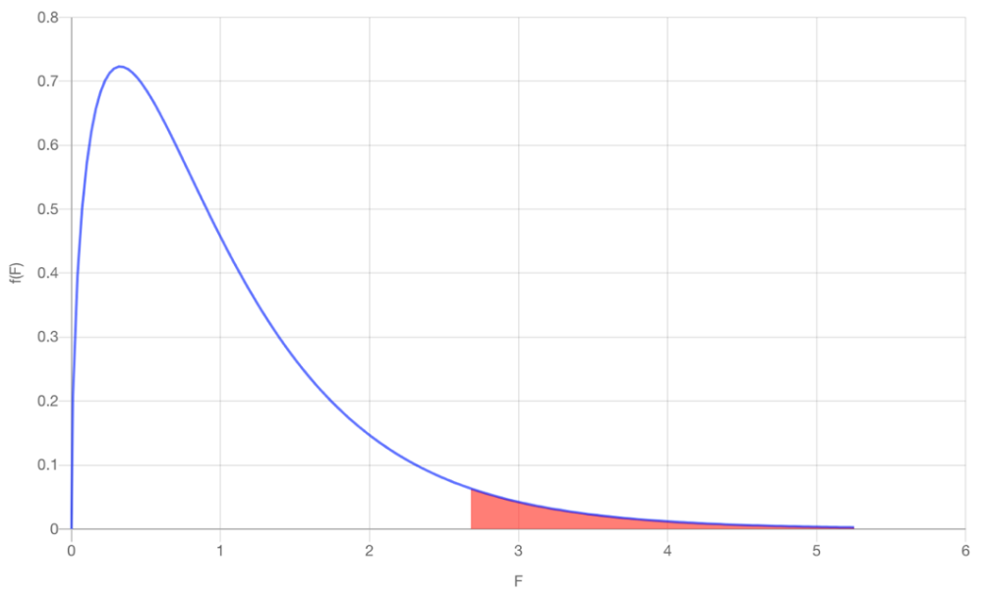
ANOVA Result Analysis
Test Statistics: The computed test statistic F equals 3.8499, which is not in the 95% region of acceptance: [-∞: 2.678].
Decision about null hypothesis: p-value equals 0.0113, [p ( x ≤ F ) = 0.988735 ]. That means, chance of type1 error (rejecting a true H0) is small: 0.0113 (1.13%). Again from sample we see, F = 3.85 > Fc​=2.678, that suggest null hypothesis is rejected
Conclusion: null hypothesis Ho is rejected for α=0.05. In other words, the difference between the averages of some groups is statistically significant. Again, from data summary we found: Means of CA + Bubble significantly higher Means of CA + Grid and VSUP + Bubble are closer Means of VSUP + Grid significantly lower Performance of CA is better than VSUP
Plot of ANOVA Results

Slide 43
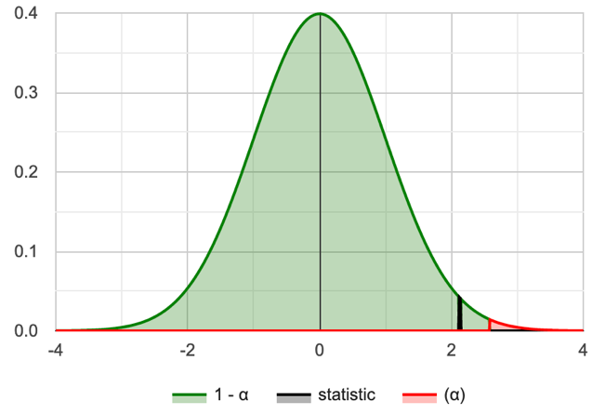
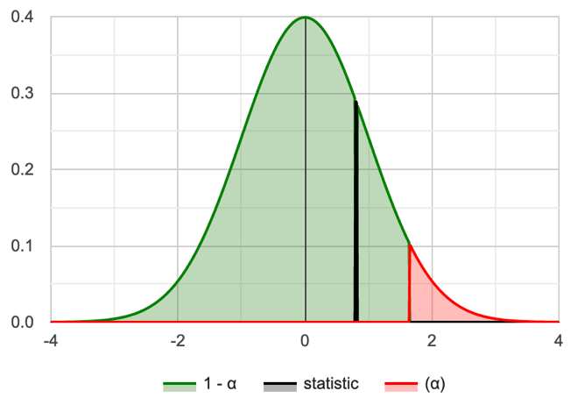
CA vs VSUP Data
Group | CA | VSUP
Mean | 5.938 | 5.422
SD | 1.105 | 1.078
SEM | 0.195 | 0.191
N | 32 | 32
Group | CA | VSUP
Skewness | -0.4622 | 0.07107
Kurtosis | -0.8658 | -0.8737
p-value | .017 | 0.017
W | 0.916 | 0.956
Data Summary
Shapiro-Wilk Normality Test
CA and VSUP normal distributions

Slide 44
t-test Results for CA vs VSUP
Null and Alternative Hypotheses
Ho: μ_{D​​} = (μ1​ - μ2) >= 0 (performance of CA is higher or equal to performance of VSUP) Ha: μ_{D} = ​(μ1​ - μ2) < 0 (performance of CA is less than performance of VSUP)
Rejection Region: R={t : t < −1.696} for critical value t_{c​} = −1.696
Test Statistics: t-statistic = 3.61
P-Value: p = 0.9995
Decision about the null hypothesis:
Based on t-statistic (t = 3.61 ≥ t_{c} ​= −1.696), the null hypothesis is not rejected By P-value approach (p = 0.9995 ≥ 0.05), the null hypothesis is not rejected
Conclusion: Performance of CA is higher to performance of VSUP

Slide 45
Time Utilization (TU) : paired t-test
Group | CA | VSUP
Mean | 8.675 | 9.647
SD | 2.320 | 3.123
SEM | 0.410 | 0.552
N | 32 | 32
Shapiro-Wilk normality tests shows that they are normal:
For CA: W(32) = 0.959, p = 0.254
For VSUP = W(32) = 0.977, p = 0.716
Data Summary
Null and Alternative Hypotheses: Ho: μ_{D​​} = (μ1​ - μ2) <= 0 (CA response was equal or faster than VSUP response) Ha: μ_{D} = (μ1​ - μ2) > 0 (CA response was slower than VSUP response)
Rejection Region: R={t : t > 1.696}, for α = 0.05 and t_{c}​ = 1.696
Test Statistics: t-statistic = -2.656
Decision about the null hypothesis: Since t = −2.656 ≤ t_{c} ​= 1.696, the null hypothesis is not rejected Since p = 0.9938 ≥ 0.05, null hypothesis is not rejected
Conclusion: CA response was faster than VSUP response

Slide 46
SUS Data
Group | CA | VSUP
Mean | 60.078 | 61.094
SD | 16.307 | 14.227
SEM | 2.883 | 2.515
N | 32 | 32
The Shapiro-Wilk tests shows that they do not meet normality test with the following results:
For CA: W(32) = 0.913, p = 0.013
For VSUP: W(32) = 0.889, p = 0.003
Data Summary
Score Calculation:
For odd items: subtract one from the user response.
For even-numbered items: subtract the user responses from 5
This scales all values from 0 to 4 (with four being the most positive response).
Add up the converted responses for each user and multiply that total by 2.5.
Range of possible values [0 to 100] instead of [0 to 40]

Slide 47
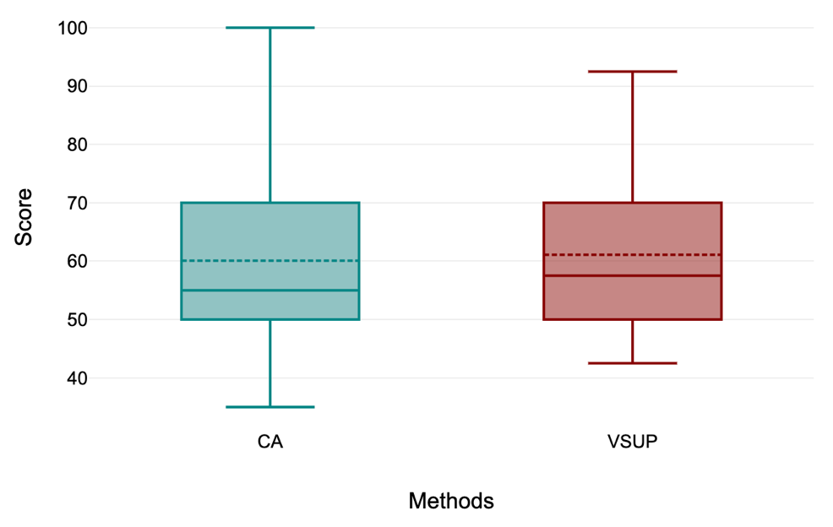
Kruskal-Wallis Test on SUS Data
Null and Alternative Hypotheses
Ho: The samples come from populations with equal medians.
Ha: The samples come from populations with medians that are not all equal.
Rejection Region: R = {χ2: χ2 > 3.841}, for df = 2 – 1 = 1, α=0.05
Test Statistics: H = 0.146
P-Value: 0.702
Decision about the null hypothesis:
Based on H-statistic (χ²=0.146 ≤ χ_{c}2​ = 3.841 ), the null hypothesis is not rejected By P-value approach (p = 0.702 ≥ 0.05 ), the null hypothesis is not rejected
Conclusion: Results do not statistically significantly vary between CA and VSUP.

Slide 48
NASA-TLX Results
Methods | NASA-TLX | Shapiro-Wilk Normality Test (α = 0.05)
 |  | Test Statistic (W) | p-value | Status
CA | Mental Demand | 0.906 | 0.009 | Not normal
 | Physical Demand | 0.914 | 0.014 | Not normal
 | Temporal Demand | 0.948 | 0.128 | Normal
 | Performance | 0.932 | 0.044 | Not normal
 | Effort | 0.942 | 0.085 | Not normal
 | Mental Frustration | 0.916 | 0.017 | Not normal
VSUP | Mental Demand | 0.863 | 0.001 | Not normal
 | Physical Demand | 0.903 | 0.007 | Not normal
 | Temporal Demand | 0.938 | 0.067 | Not normal
 | Performance | 0.887 | 0.003 | Not normal
 | Effort | 0.901 | 0.006 | Not normal
 | Mental Frustration | 0.877 | 0.002 | Not normal
Normality test results

Slide 49
Kruskal-Wallis Test on NASA-TLX Data
Null and Alternative Hypotheses
Ho: The samples come from populations with equal medians.
Ha: The samples come from populations with medians that are not all equal.
NASA-TLX | X2 | P | df | H | Conclusion
Mental Demand | 0.19 | 0.6626 | 1 | 0.19 | Not Rejected
Physical Demand | 0.062 | 0.8038 | 1 | 0.062 | Not Rejected
Temporal Demand | 0.018 | 0.8932 | 1 | 0.018 | Not Rejected
Performance | 3.61 | 0.0574 | 1 | 3.61 | Not Rejected
Effort | 0.062 | 0.8038 | 1 | 0.062 | Not Rejected
Mental Frustration | 0.173 | 0.6772 | 1 | 0.173 | Not Rejected

Slide 50
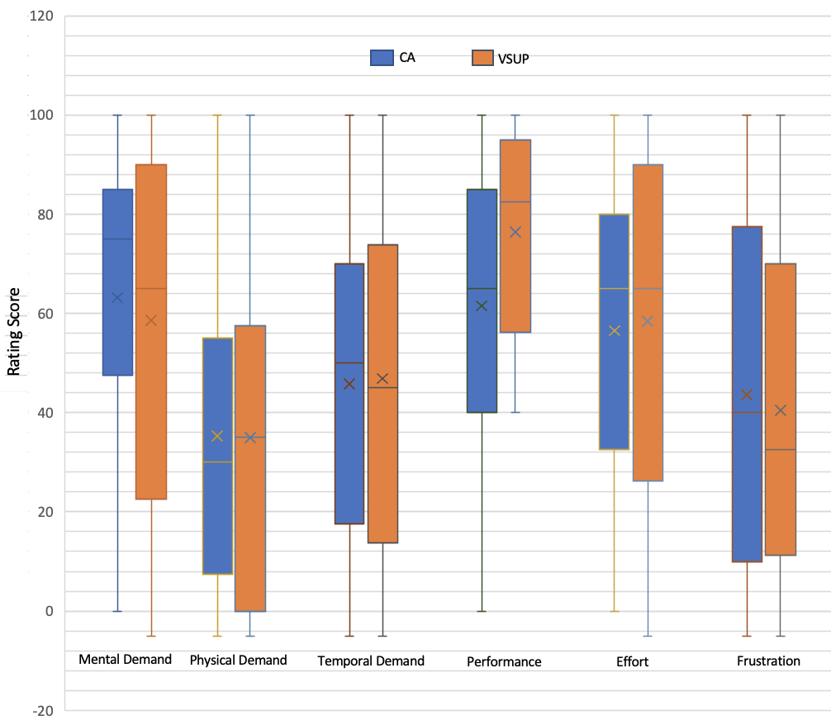
NASA-TLX Results
Conclusion: Although box-plot shows slight differences in medians but the overall results are not statistically significant.
Box Plot of six questions responses

Slide 51
Conclustions and Future Work

Slide 52
Contributions of Thesis
Implemented a new technique to represent uncertainties with chromatic aberration (CA)
Explored the use of CA on a variety of charts
CA approach outperforms an state-of-the-art mechanism VSUP in charts tested

Slide 53
Conclusion
User performance and perception for CA statistically surpasses VSUP.
CA is faster than VSUP in terms of task completion time by the users.
Subjective assessments show that both CA and VSUP are statistically similar.

Slide 54
Future work
A further study could be conducted with more levels uncertainties
CA might also be explored and studied with animated visualizations
Refine and expand upon some of our other experimental designs such as Starfish layout streamgraph.

Slide 55
Questions?

Slide 56
References
Michael Correll, Dominik Moritz, Jeffrey Heer. Value-Suppressing Uncertainty Palettes. Proceedings of the 2018 CHI Conference on Human Factors in Computing Systems. April 2018. Paper No.: 642 Pages 1–11.
Song, Xin; Xiao, Jun PhD; Deng, Jiang PhD; Kang, et al. Time series analysis of. influenza incidence in Chinese provinces from 2004 to 2011. Received March 1, 2016, Accepted May 20, 2016, Medicine: June 2016 - Volume 95 - Issue 26 - p e3929
Christophorus Beneditto, Aditya Satrio et al. Time series analysis and forecasting of coronavirus disease in Indonesia using ARIMA model and PROPHET, https://doi.org/10.1016/j.procs.2021.01.036
Stéfan van der Walt and Nathaniel Smith. 2015. Mpl colormaps. https://bids.github.io/colormap/, (2015).
Keppel, Geoffrey: Design and Analysis, 3rd Edition. Prentice-Hall.

Slide 57
References
M. K. Johnson & H. Farid. 2006. Exposing digital forgeries through chromatic aberration. Multimedia and security, Geneva, Switzerland, 48-55
Aasim Kamal · Parashar Dhakal, et al. Recent advances and challenges in uncertainty visualization: a survey. May 2021, Journal of Visualization 24(5):1-30.
Shapiro, S. S.; Wilk, M. B. (1965). "An analysis of variance test for normality (complete samples)". Biometrika. 52 (3–4): 591–611. Stéfan van der Walt and Nathaniel Smith. 2015. Mpl colormaps. https://bids.github.io/colormap/, (2015).
Henning Griethe et al. The Visualization of Uncertain Data: Methods and Problems. Computer Graphics, 18051 Rostock, Germany. January 2006, 2,988 reads, 36 publications, 262 citations.
Pang, A., Wittenbrink, C., Lodha., S.: Approaches to uncertainty visualization. The Visual Computer 13(8), 370–390 (1997).
R. Finger and A. M. Bisantz. Utilizing graphical formats to convey uncertainty in a decision-making task. Theoretical Issues in Ergonomics Science, 3(1):1–25, 2002

Slide 58
References
K. Koh, B. Kim & J. Seo. 2014. Effect of lateral chromatic aberration for chart reading in information visualization on display devices. Advanced Visual Interfaces. Como, Italy, 289-292
M. K. Johnson & H. Farid. 2006. Exposing digital forgeries through chromatic aberration. Multimedia and security, Geneva, Switzerland, 48-55.
Deitrick, S., Edsall, R.: The influence of uncertainty visualization on decision making: An empirical evaluation. In: Progress in Spatial Data Handling, pp. 719–738. Springer Berlin Heidelberg (2006).
Aasim Kamal · Parashar Dhakal, et al. Recent advances and challenges in uncertainty visualization: a survey. May 2021, Journal of Visualization 24(5):1-30.

Slide 59
Extra Slides for Questions

Slide 60
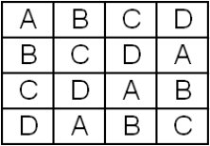
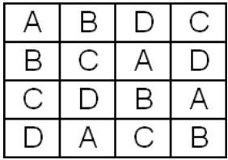
Counter Balancing
To balance learning effect of within-subject design
Marked Bs have higher learning tendency
Latin Square Balanced Latin Square

Slide 61
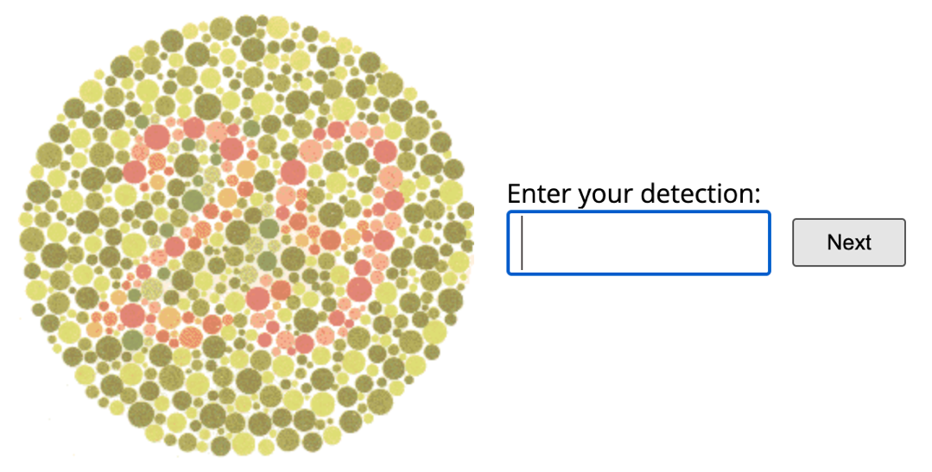
Color Blindness Test

Slide 62
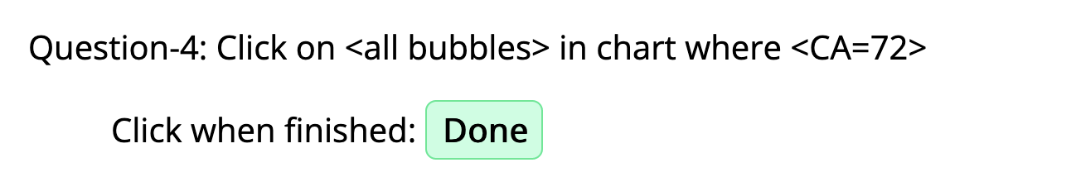
Type of Questions
Single Variable and Single Answer
Single Variable and All Answer
Double Variables

Slide 63
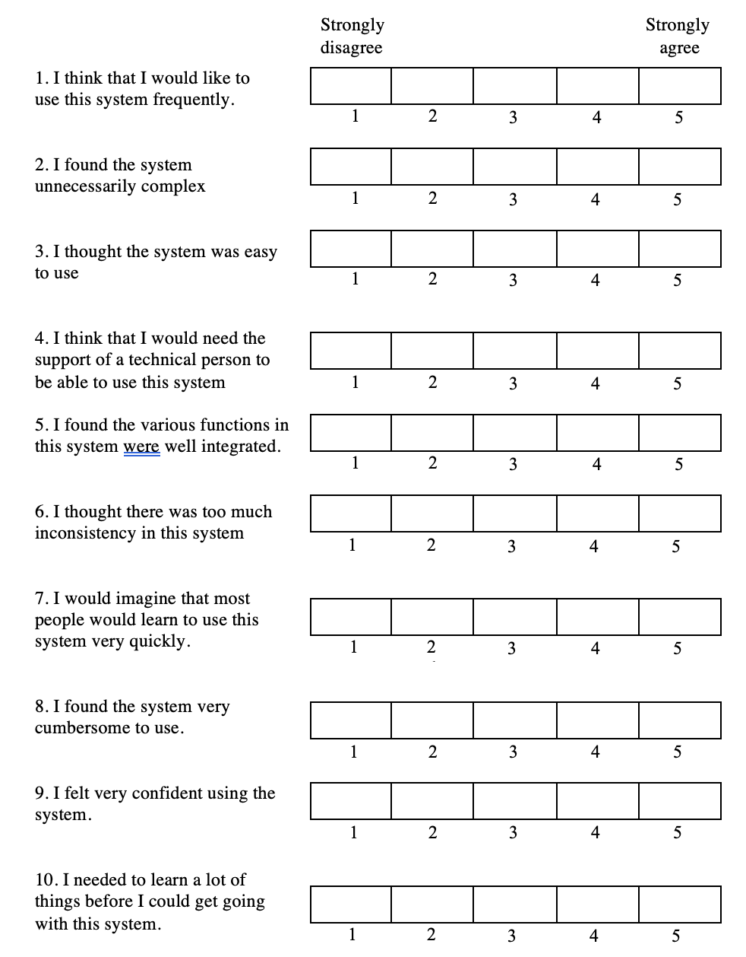
SUS Questions

Slide 64
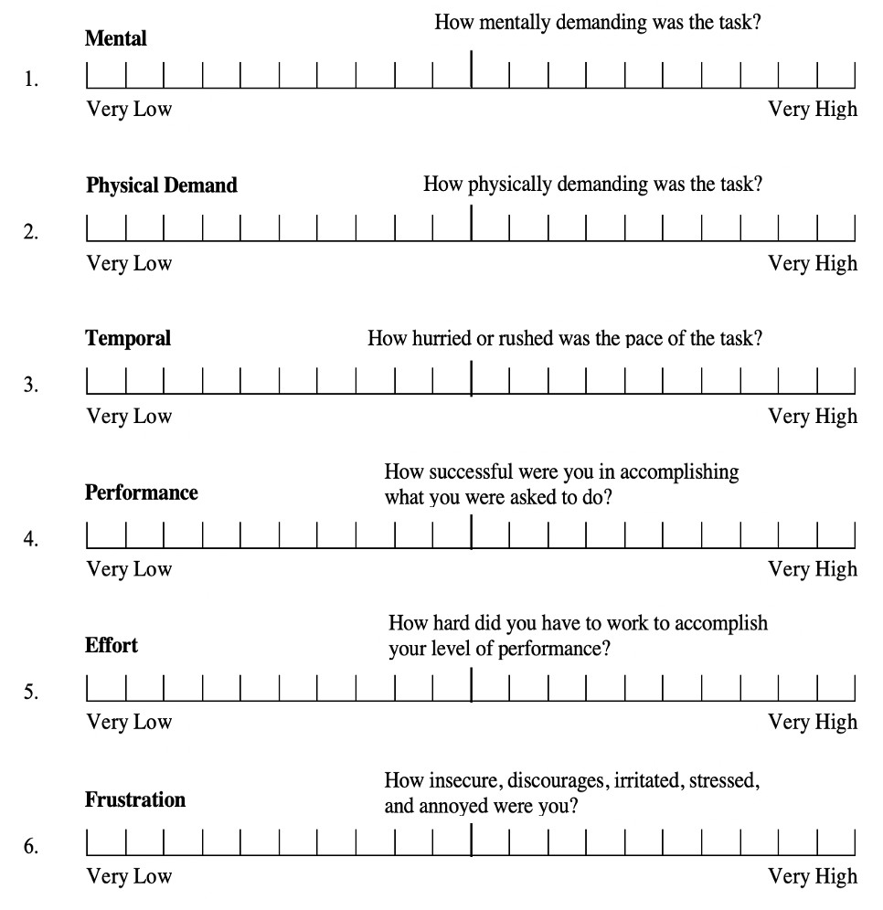
NASA-TLX Questions

Slide 65
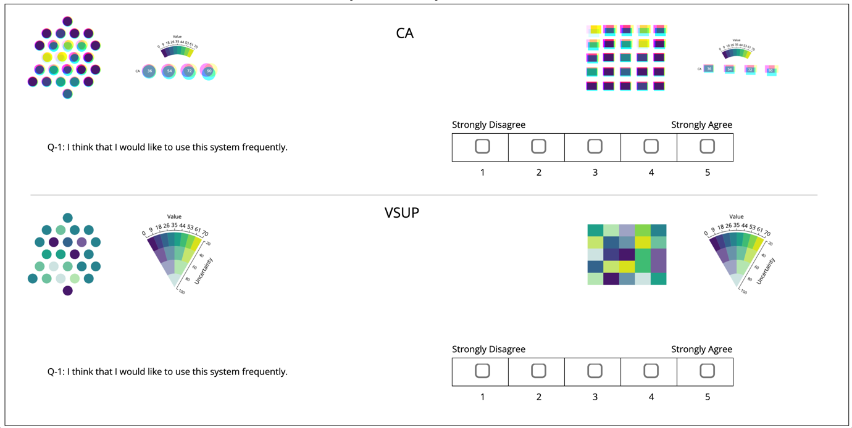
SUS Question Interface

Slide 66
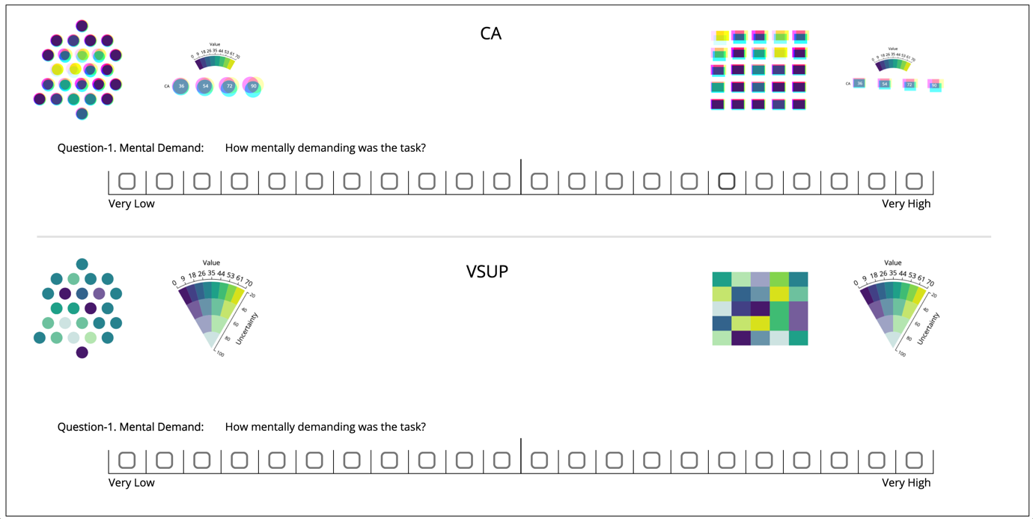
NASA-TLX Question Interface

